Slide 1
TIME SERIES MODEL ON PROJECTING EST REV

Slide 2

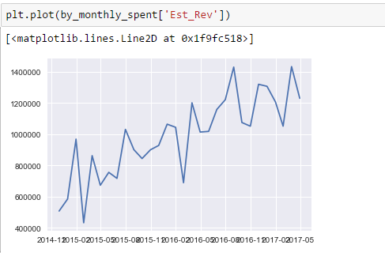
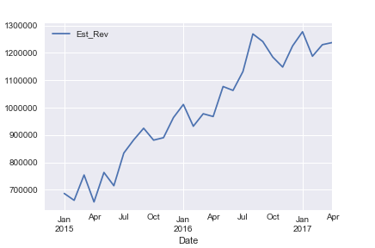
DATA SET
Rolling Months – Est Rev

Slide 3
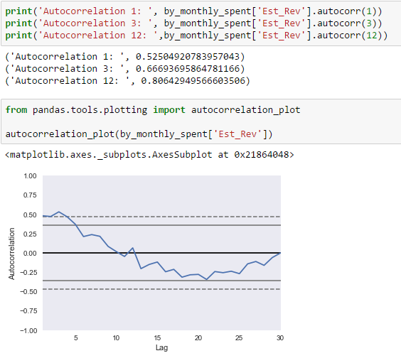
AUTO CORRELATION

Slide 4
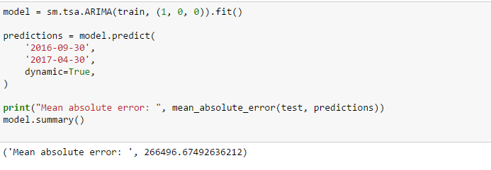
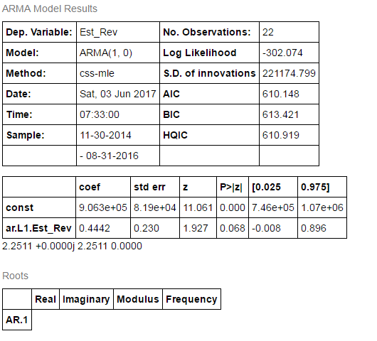
ARIMA MODELS

Slide 5
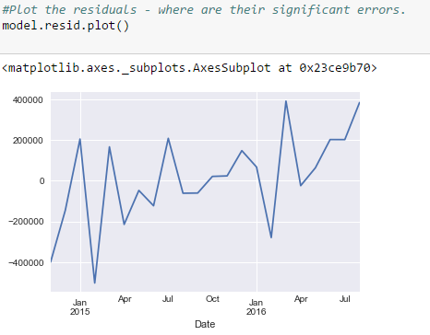
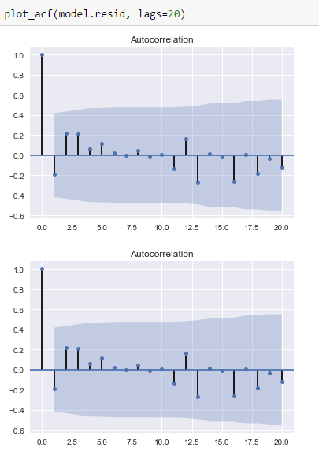
ARIMA MODELS

Slide 6
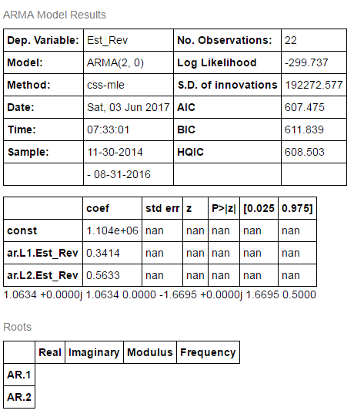

ARIMA MODELS

Slide 7
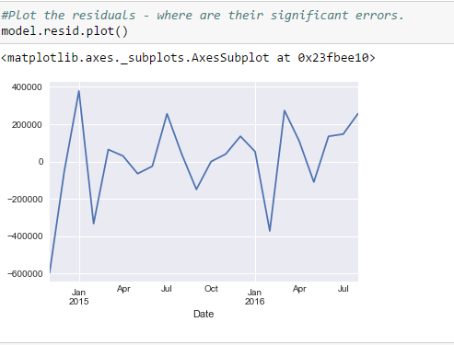
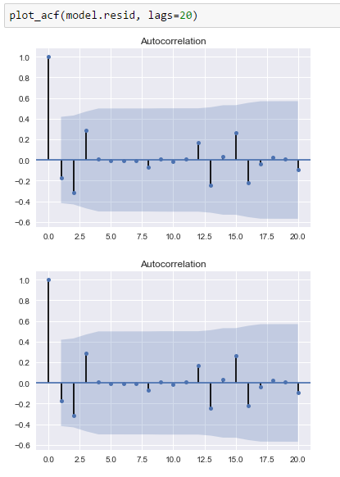
ARIMA MODELS
Mean Absolute error increased

Slide 8
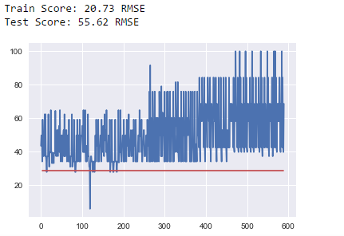
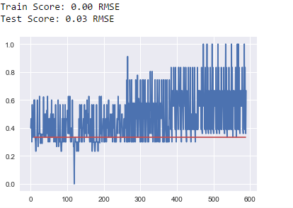
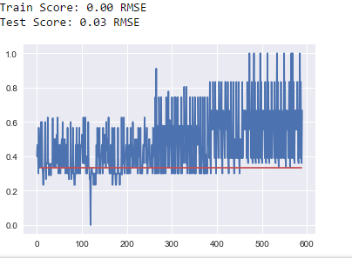
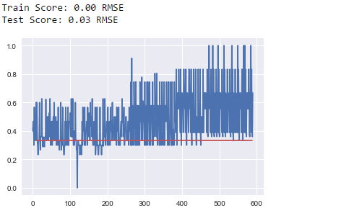
APPLYING Long Short-Term Memory Network (LSTM)
LSTM Network for Regression
LSTM for Regression Using the Window Method
LSTM for Regression with Time Steps
LSTM with Memory Between Batches

